Slide 1

E-Commerce Training Slide

Slide 2
Trainer’s Name
“What will be taught”

Slide 3
E-Commerce
Online Market Places, Digital Payments, E-Banking, Security

Slide 4
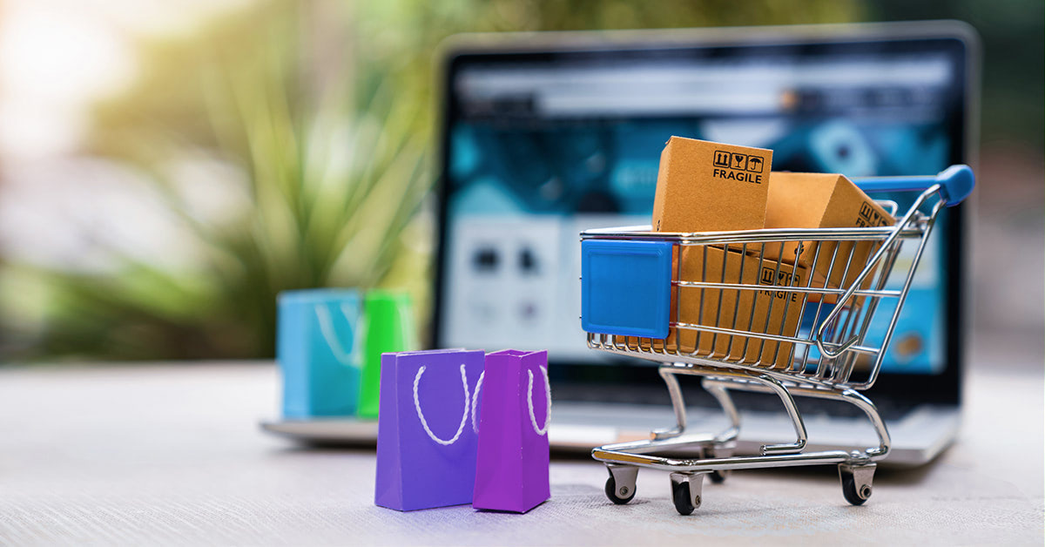
E-Commerce: Electronic Commerce
Buying and selling goods or services over the internet.

Slide 5
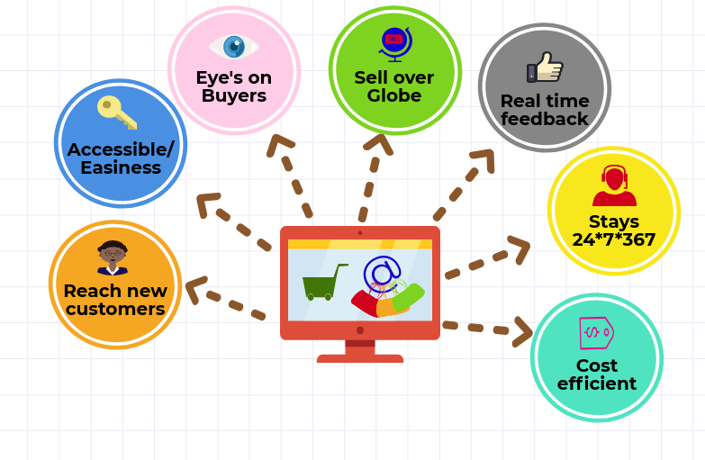
Advantages of E-Commerce

Slide 6
1
Online
Market Places

Slide 7
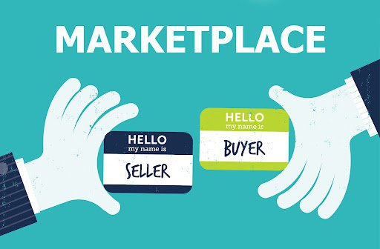
Online Market Places
Online platforms
that connect buyers and sellers

Slide 8
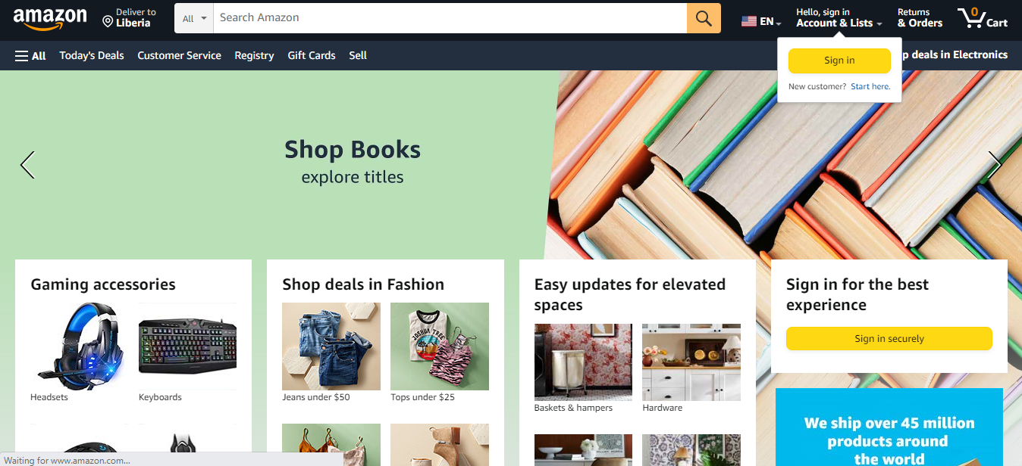
Examples of Market Places in the World

Slide 9
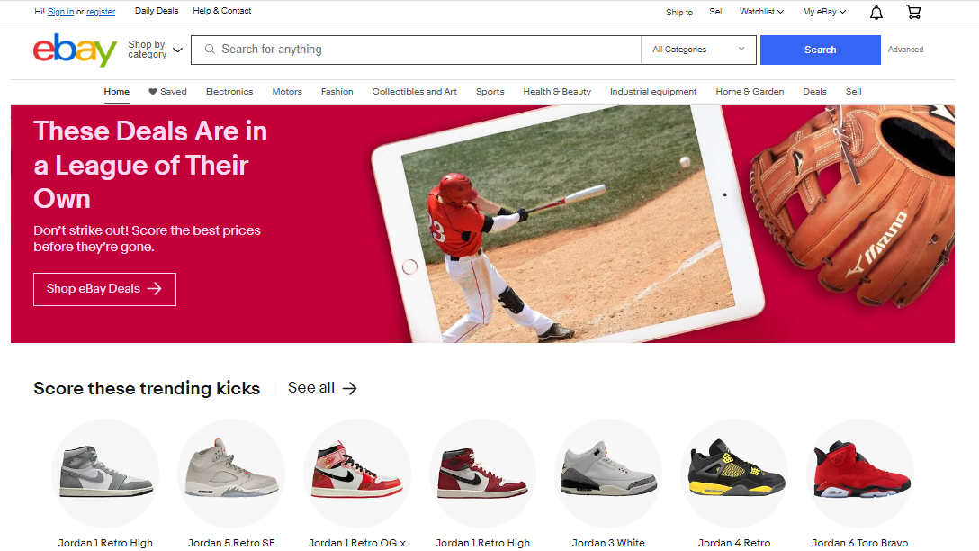
Examples of Market Places in the World

Slide 10
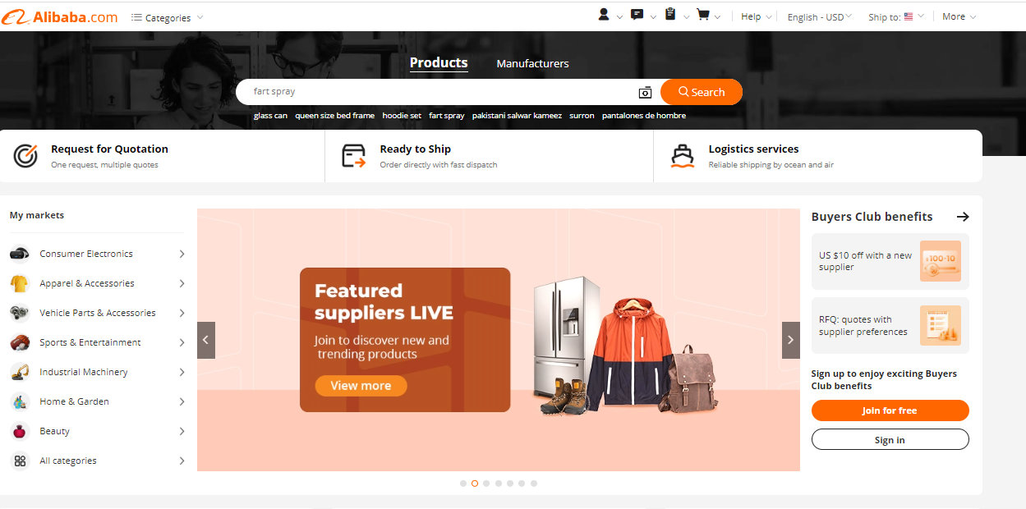
Examples of Market Places in the World

Slide 11
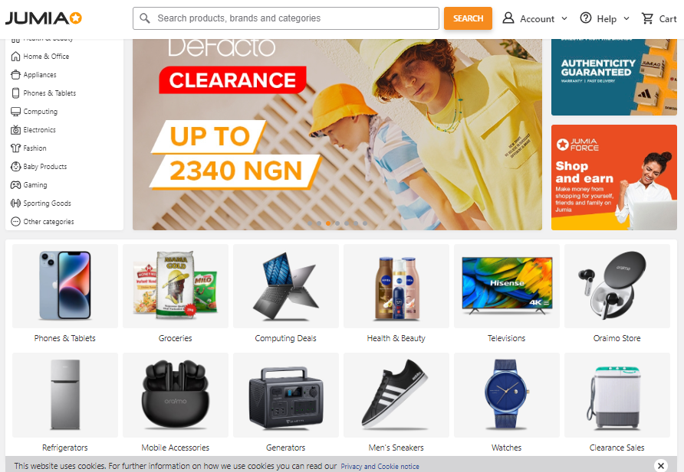
Examples of Market Places in Africa

Slide 12
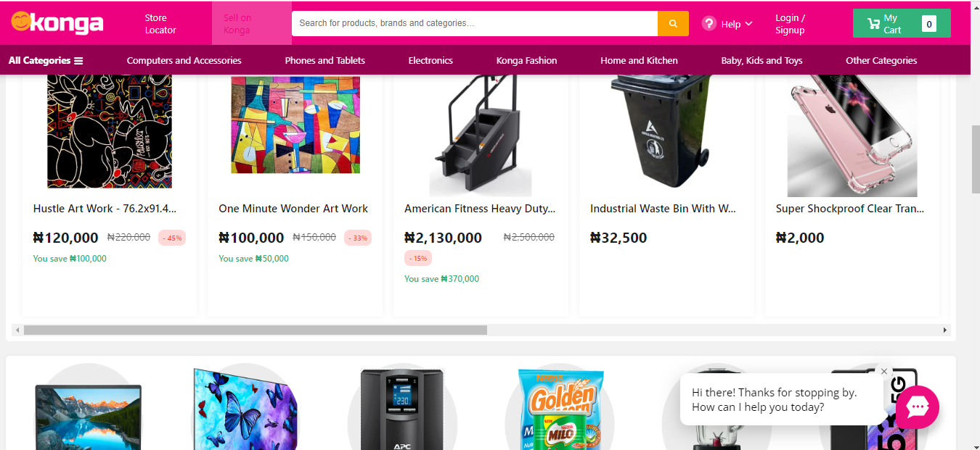
Examples of Market Places in Africa

Slide 13
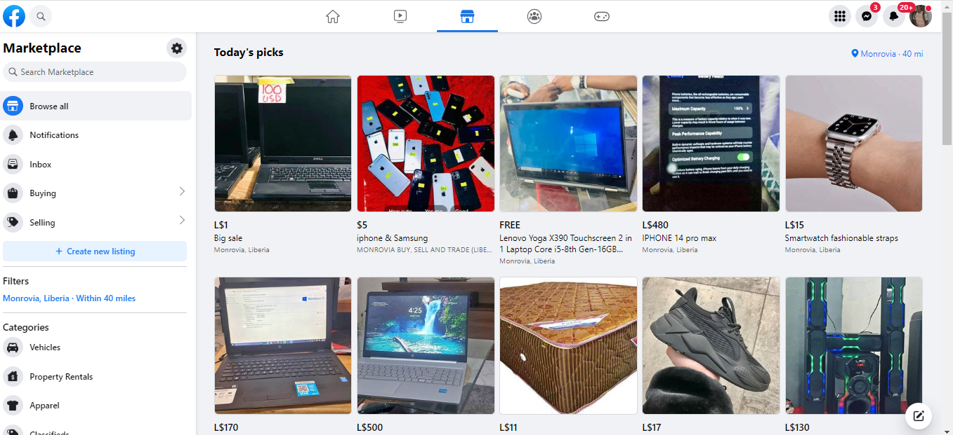
Examples of Market Places in Liberia

Slide 14
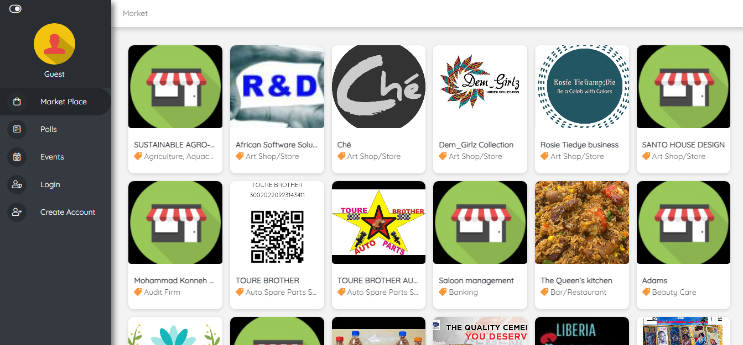
Examples of Market Places in Liberia

Slide 15
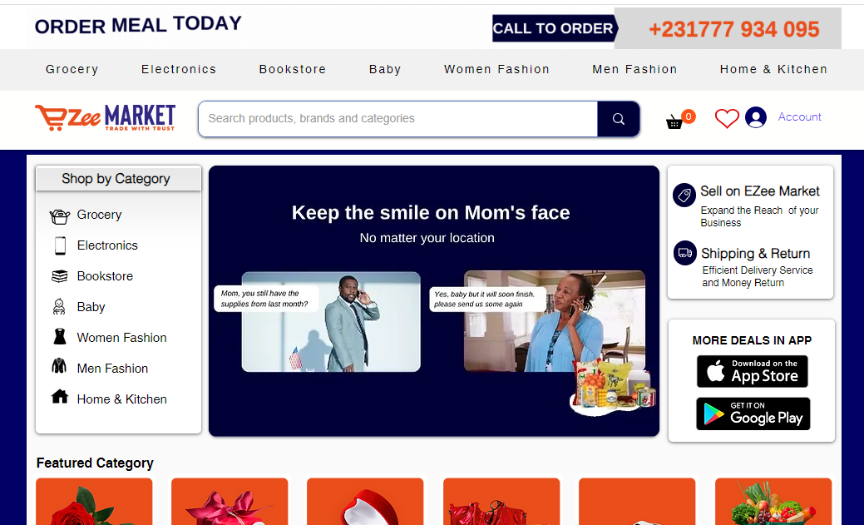
Examples of Market Places in Liberia

Slide 16
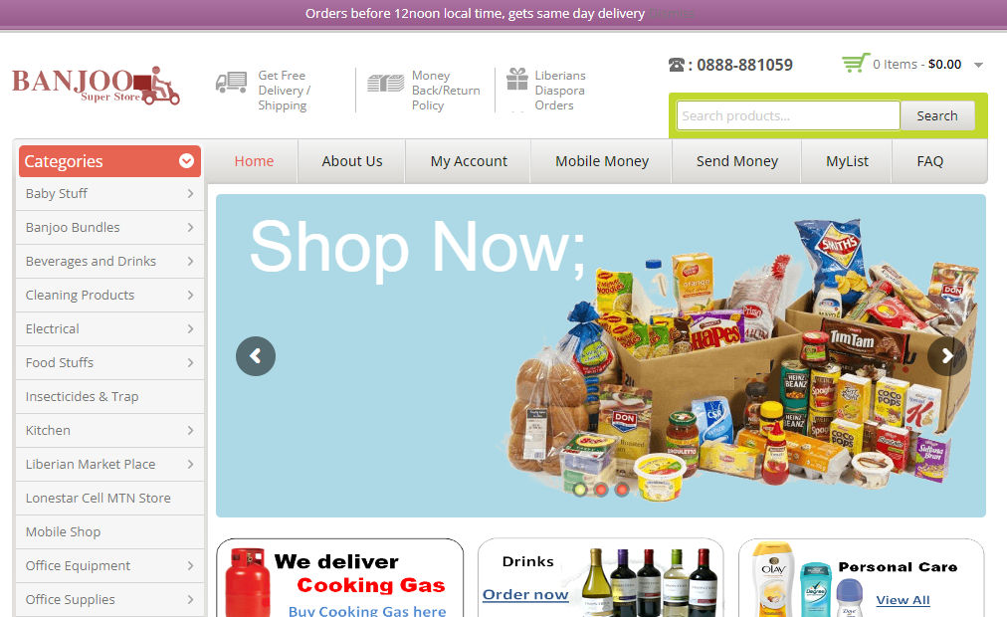
Examples of Market Places in Liberia

Slide 17
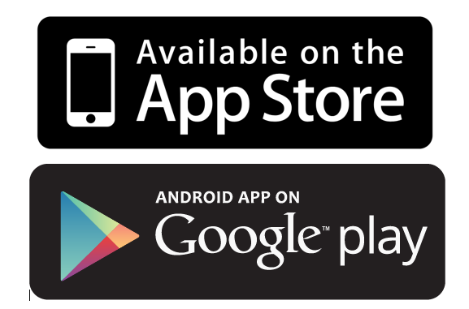

Creating an Account on a Market Place in Liberia: Case Study E-Wallie
https://ewallie.com

Slide 18
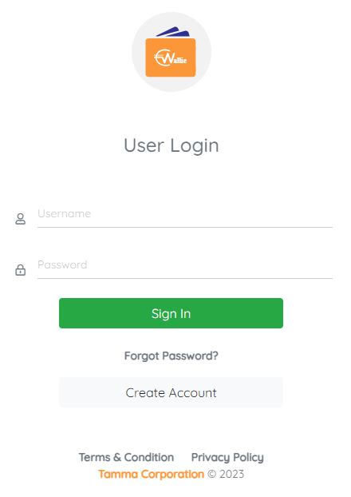
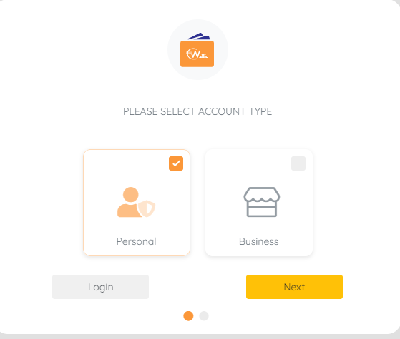
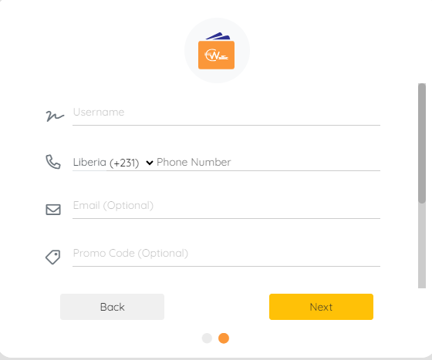
Creating an Account on a Market Place in Liberia: Case study E-Wallie
1.
2.
3.

Slide 19

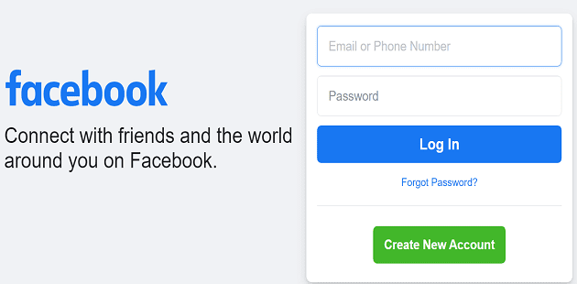
Creating an Account on a Market Place: Case Study Facebook
https://facebook.com
Requires a FACEBOOK ACCOUNT

Slide 20
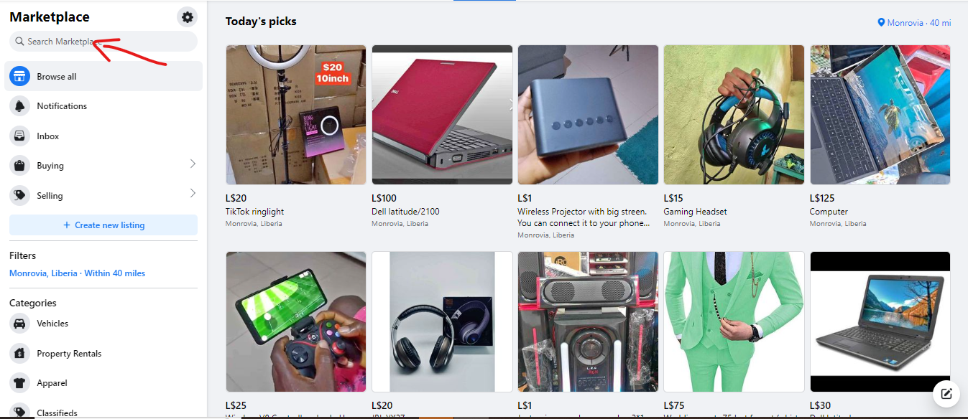
Searching for goods on an online market Place: Case study Facebook

Slide 21
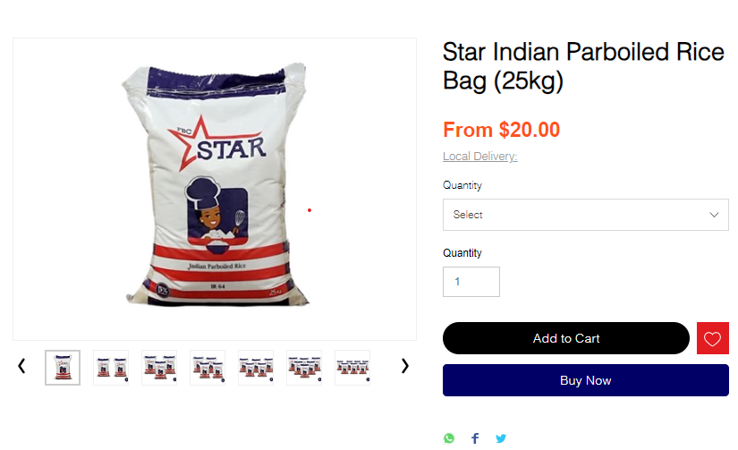
Making Payments online market Place in Liberia: Case study Ezee Market

Slide 22
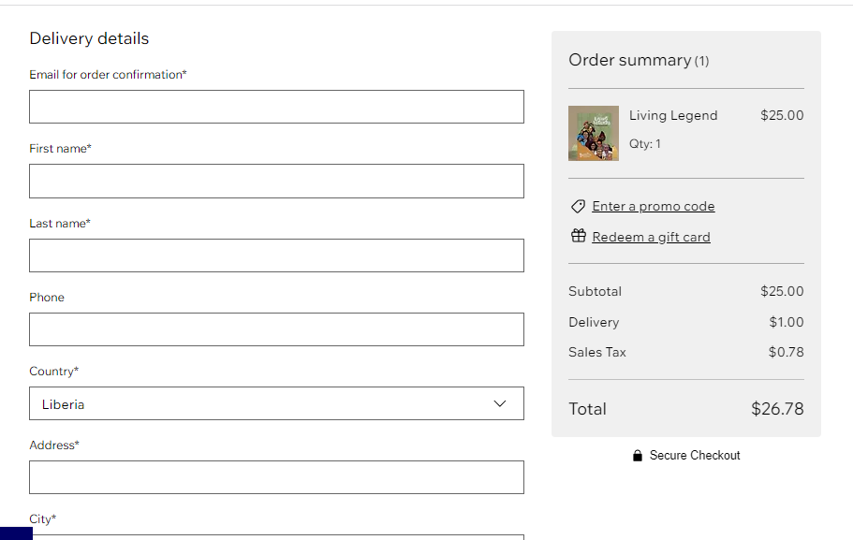
Making Payments on an online market Place in Liberia: Case study Ezee Market

Slide 23
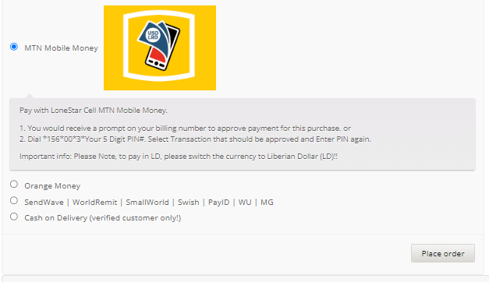
Making Payment on an online market Place in Liberia: Case study Banjoo

Slide 24
2
Digital Payment

Slide 25
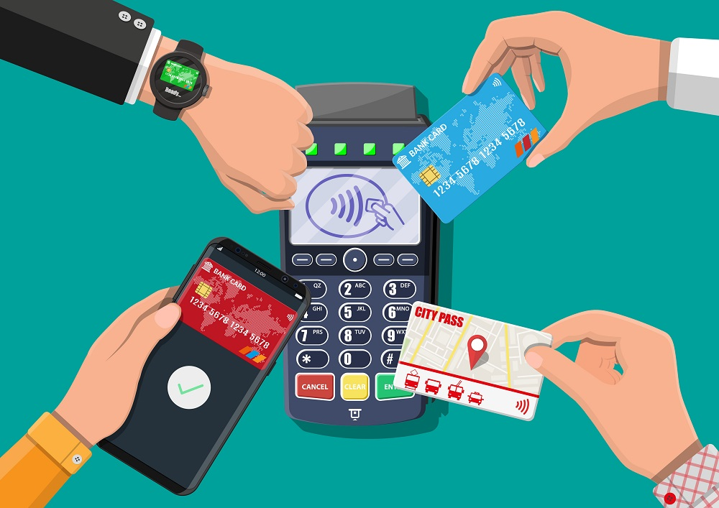
Digital Payments
Financial transaction conducted electronically,
without the use of physical cash.

Slide 26
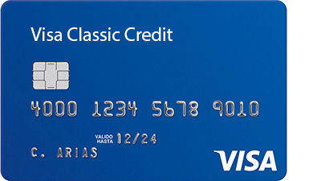
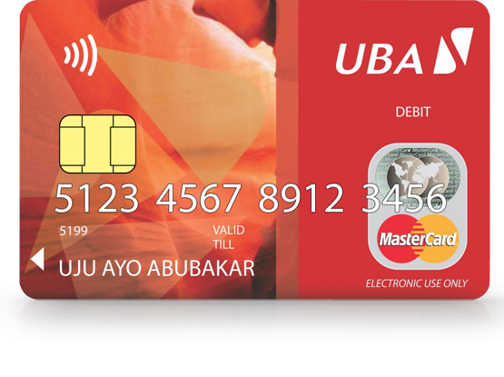
Examples of Digital Payments
Credit Card
Debit Card

Slide 27
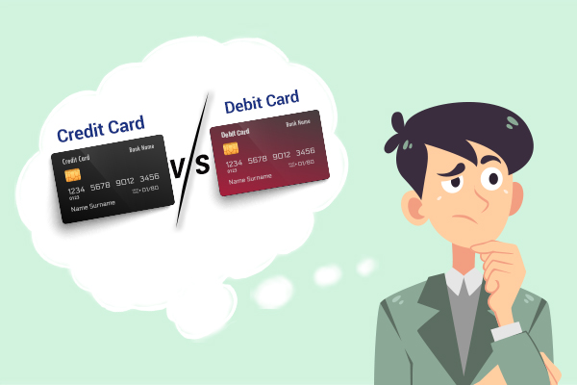
Learn more: Credit Card vs Debit Card
Credit cards involves borrowing money from the card issuer.
Debit cards use funds directly from the linked bank account.

Slide 28
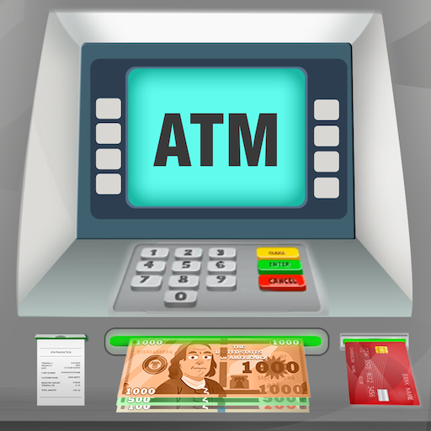
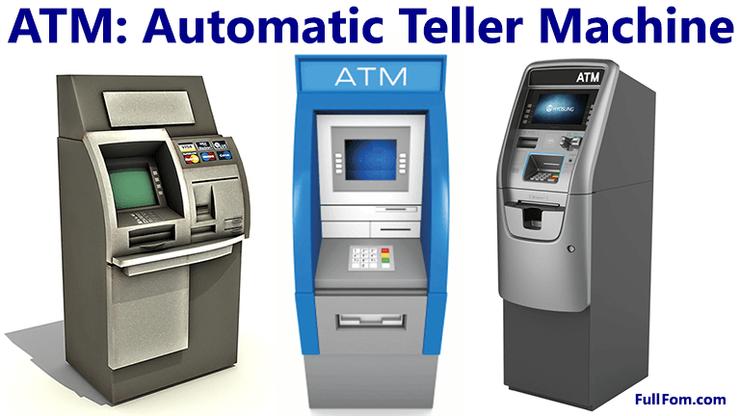
Learn More: Machines that read E-Cards

Slide 29
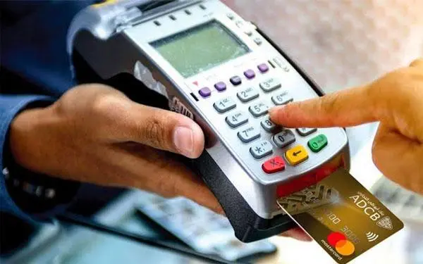
Learn More: Machines that read E-Cards
Card Reader

Slide 30
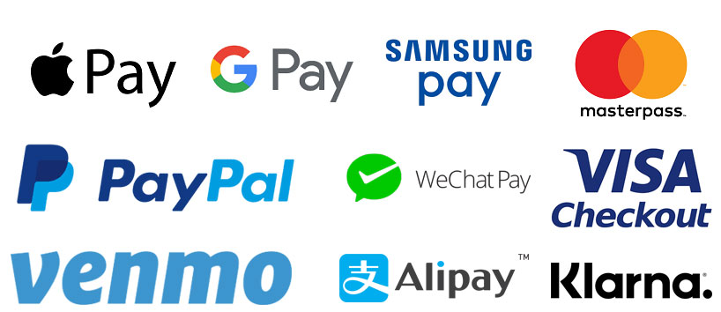
Examples of Digital Payments: E-Wallets in the World

Slide 31
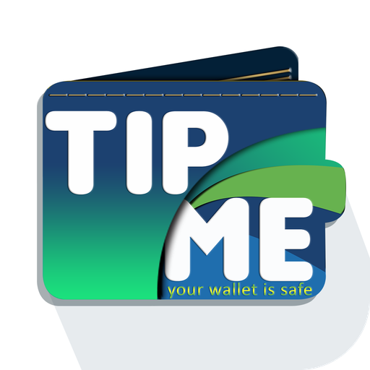



Examples of Digital Payments: E-Wallets in Liberia

Slide 32
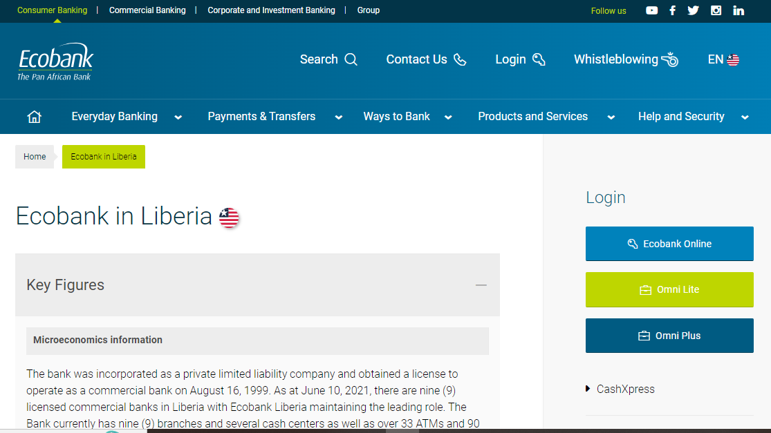
Examples of Digital Payments: Online Banking in Liberia

Slide 33
3
E-Banking

Slide 34
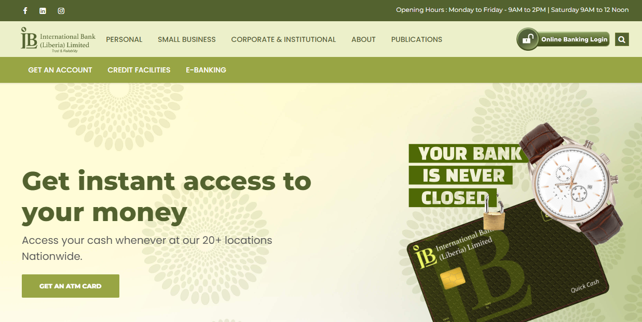
E-Banking: Online Banking in Liberia

Slide 35
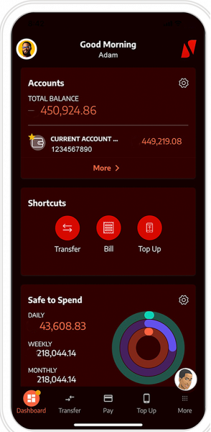
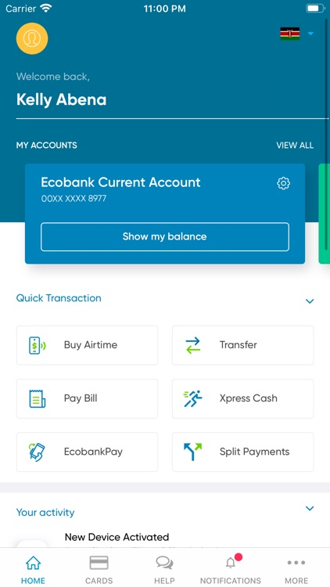
Examples of Digital Payments: Mobile App

Slide 36
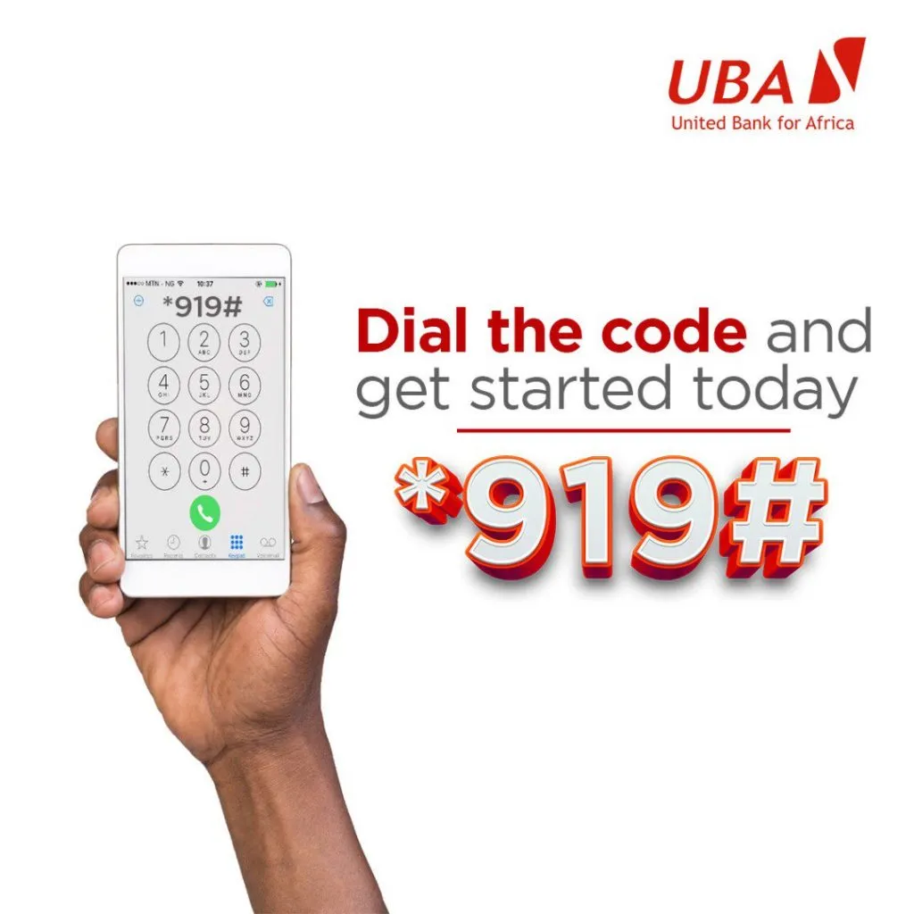
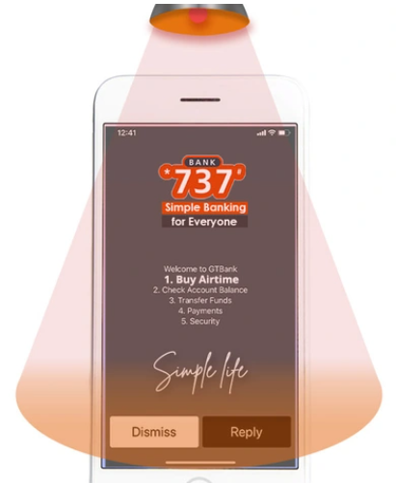
E-Banking: USSD

Slide 37
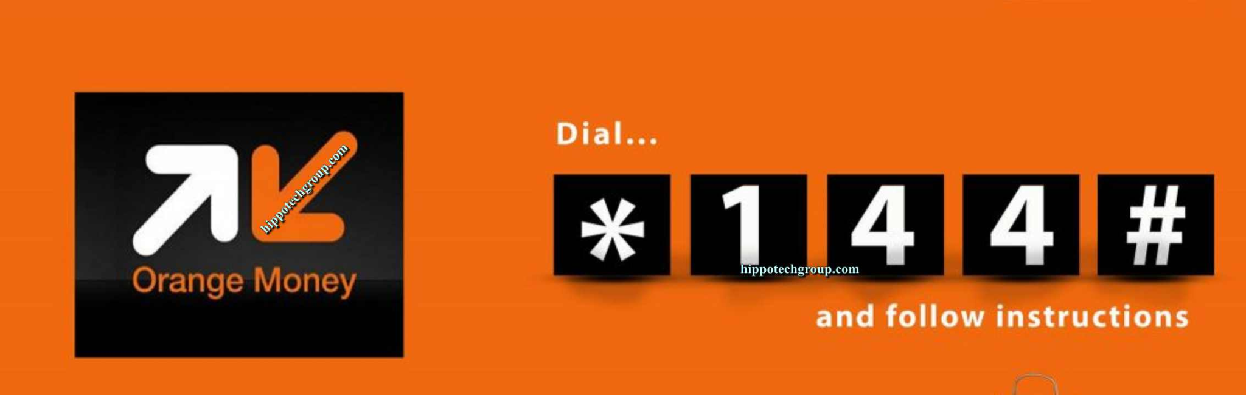
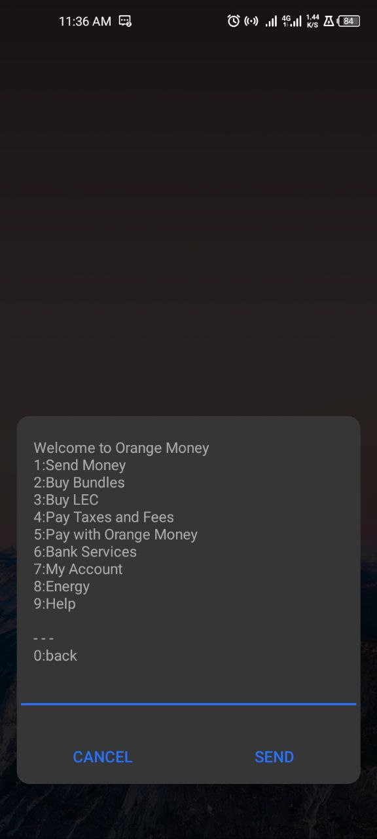
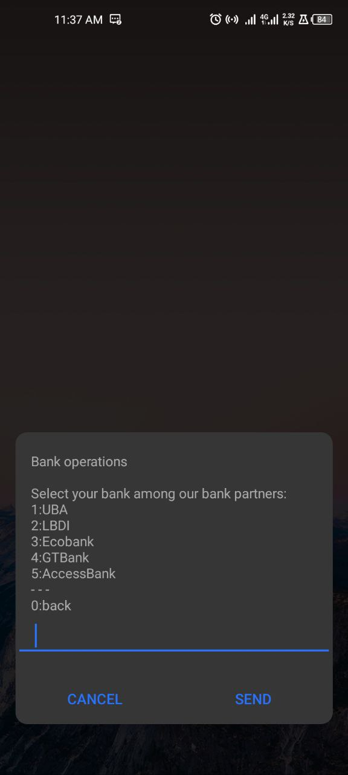
E-Banking: E-Wallets
List of Orange Money Services
Available banks on Orange Money

Slide 38
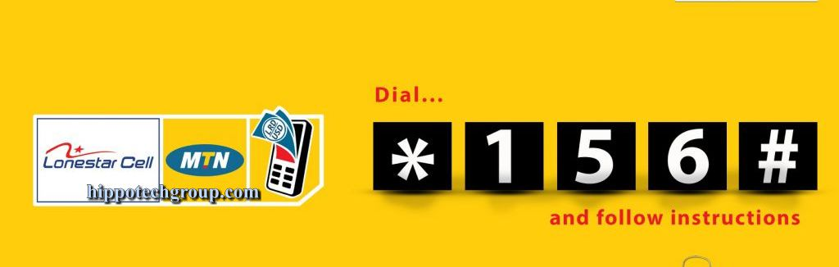
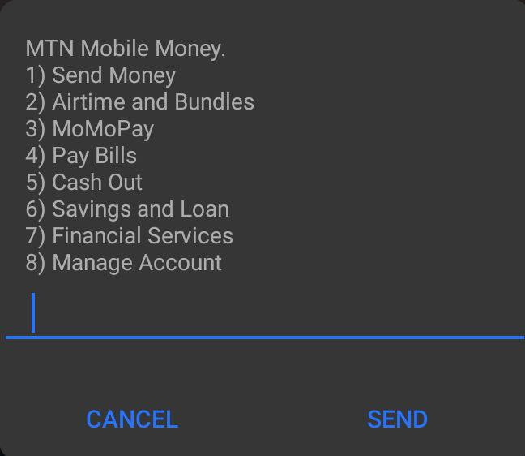
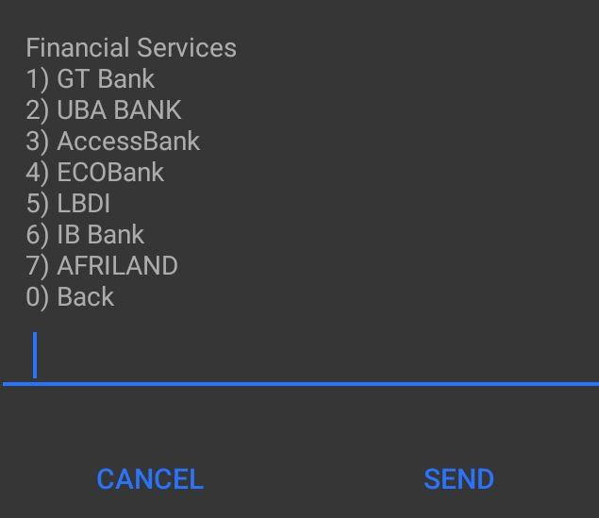
E-Banking: E-Wallets
List of Mobile Money Services
Available banks on Mobile Money

Slide 39
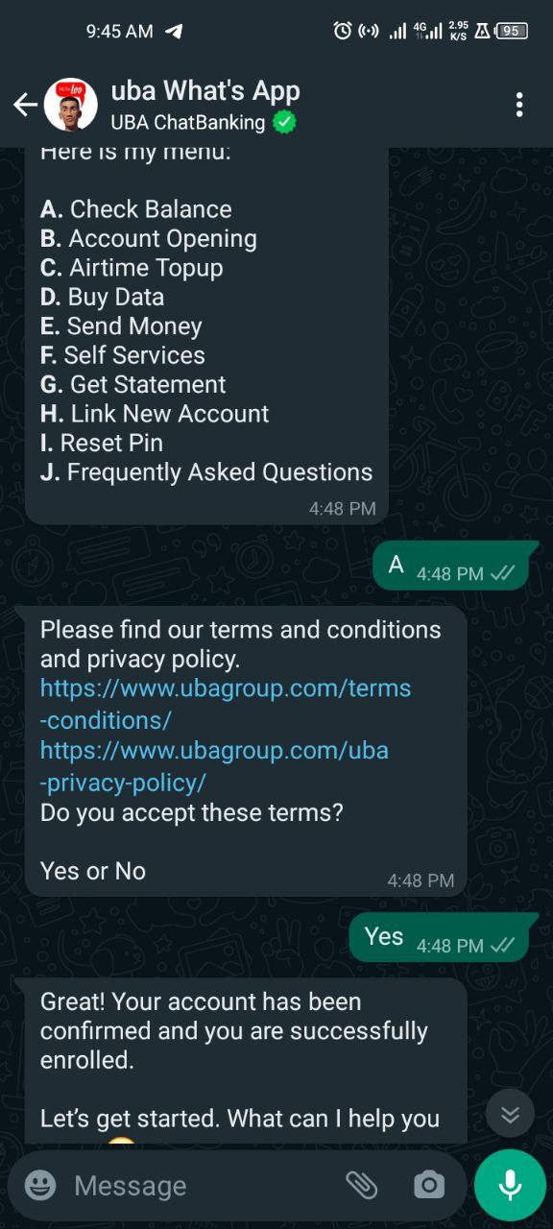
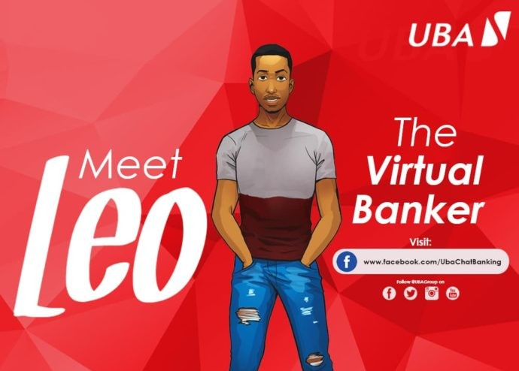
E-Banking: AI Chatbot
LEO on WhatsApp

Slide 40
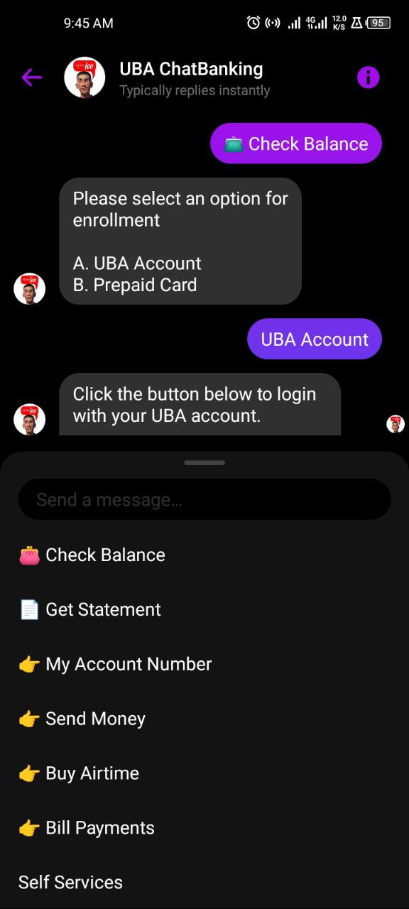
E-Banking: AI Chatbot
LEO on WhatsApp
LEO on Messenger
Notes:
Open to

Slide 41
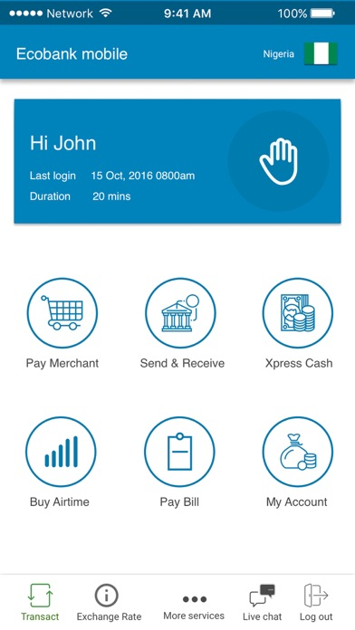
Digital Financial Transactions
Pay Bills
DSTV, LEC

Slide 42
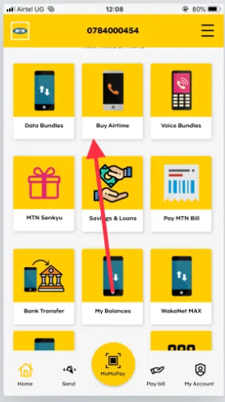
Digital Financial Transactions
Buy Airtime

Slide 43
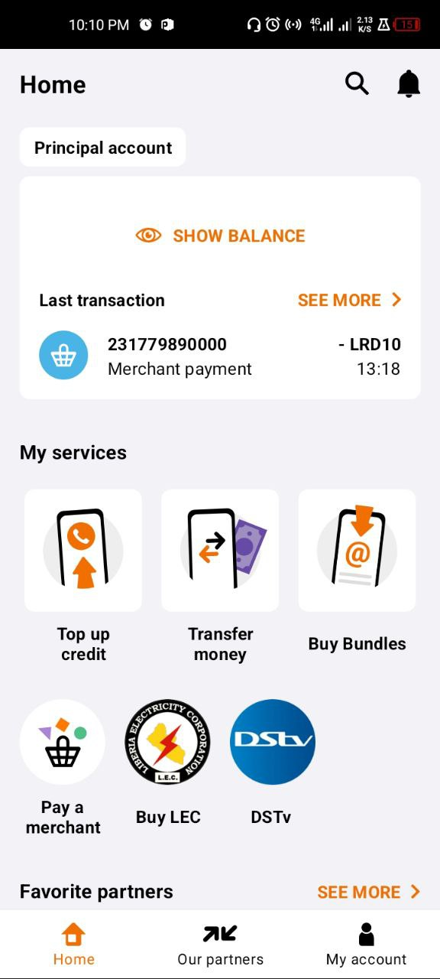
Digital Financial Transactions
Money Transfer

Slide 44
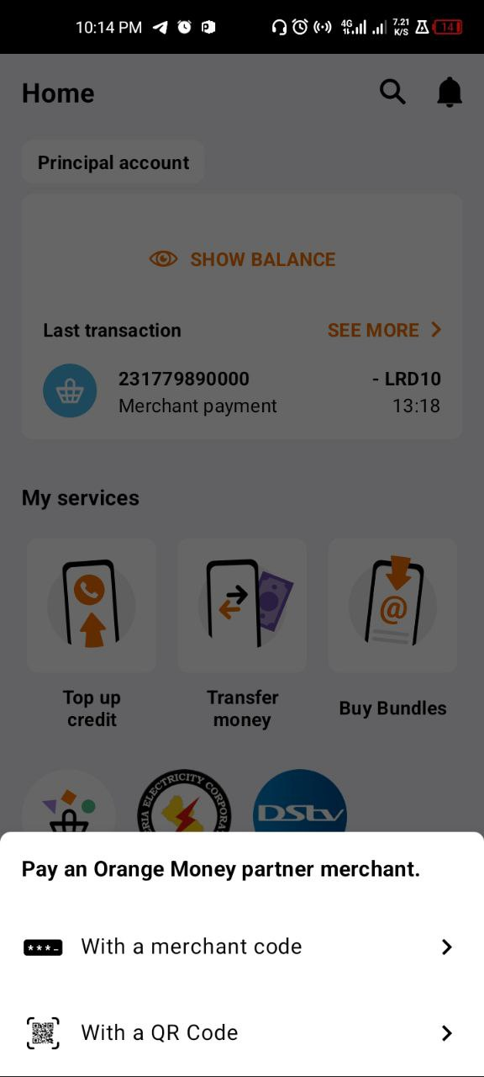
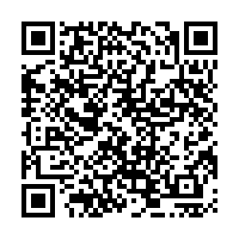

Digital Financial Transactions
Pay a Merchant

Slide 45
Digital Financial Transactions
Check Your Balance

Slide 46

Digital Financial Transactions
View
Transaction
History

Slide 47
4
Digital
Financial Security

Slide 48


Digital Financial Security
1
Use Secure and Trusted Platforms

Slide 49

Digital Financial Security
2
Protect Personal Information
Avoid sharing your passwords, PIN, or credit card details
Use strong Passwords
Use 2 Factor Authentication

Slide 50

Digital Financial Security: 2 Factor Authentication(2FA)
Requires two different types of information to verify your identity.
First: Password or PIN
Second: Typically your Mobile phone

Slide 51

Digital Financial Security
3
Keep Your Software Device Updated

Slide 52

Digital Financial Security
4
Beware of Phishing
Online scam
Deception to get Passwords or payment details.
They use text messages, emails, links, calls

Slide 53

Digital Financial Security
Strong passwords includes a combination of
letters (upper and lower case), numbers, and symbols.
5.
Use Strong Passwords

Slide 54
Digital Financial Security
6.
Regularly Monitor Accounts
Bank statements, e-wallet transaction history

Slide 55

Digital Financial Security
7.
Be Cautious
of Public Wi-Fi
Avoid conducting financial transactions on Pulic Wi-Fi

Slide 56

Digital Financial Security
8.

Slide 57
Question
and
Answer

